Slide 1

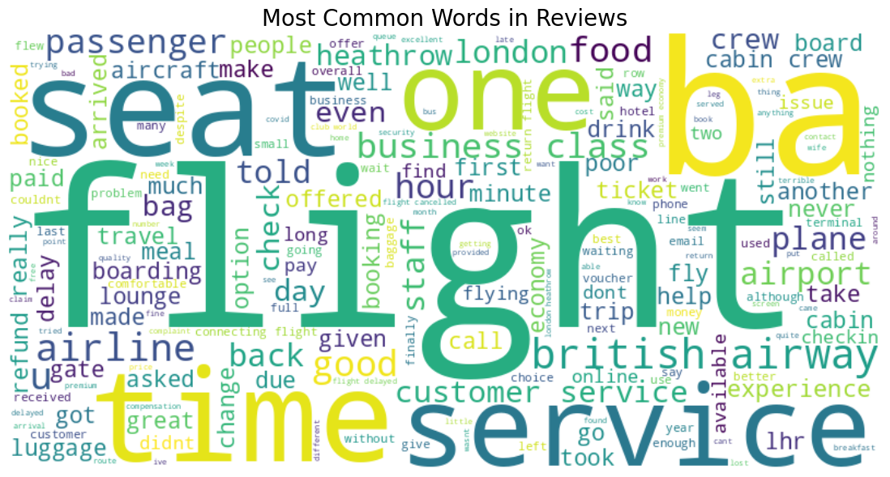
CUSTOMER REVIEW ANALYSIS
WEB SCRAPING, DATA CLEANING, SENTIMENT ANALYSIS AND TOPIC MODELLING TO GAIN COMPANY INSIGHTS

Slide 2
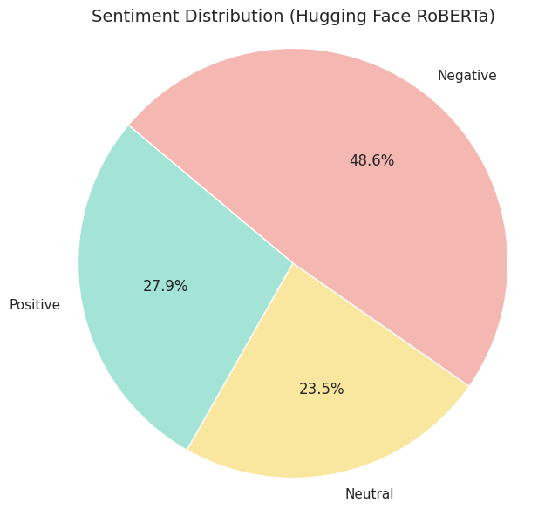
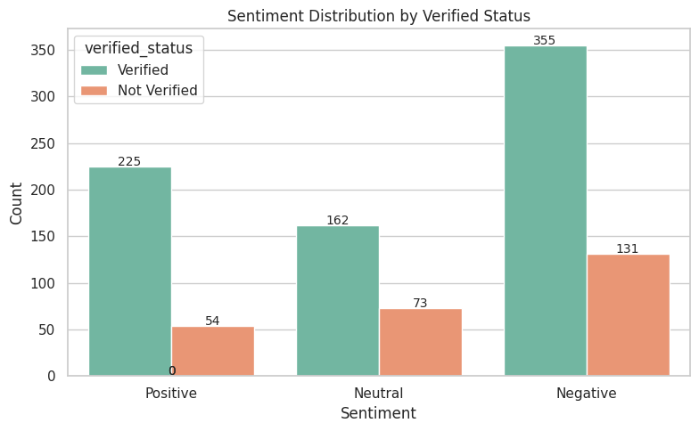
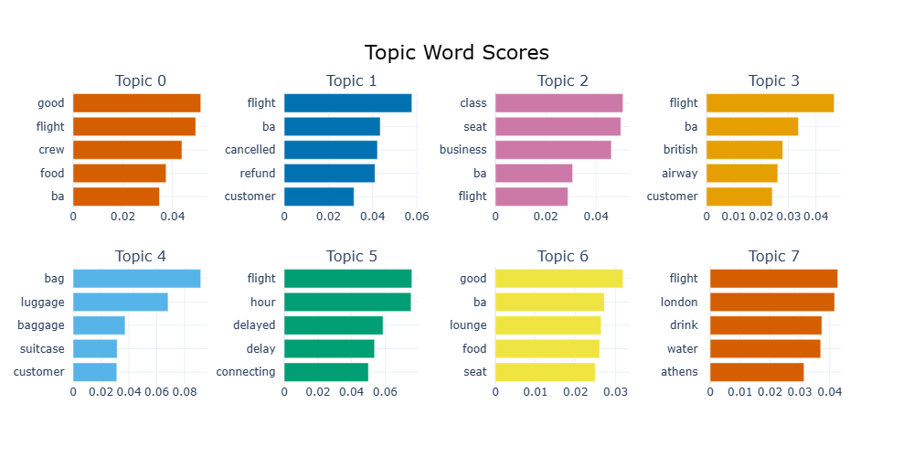
INSIGHTS FROM CUSTOMER REVIEWS
Analyzed 1000 airline reviews from Skytrax to extract sentiment.
Sentiment Results: Positive: 279 | Negative: 486 | Neutral: 235
Top 3 Topics Identified:
Topic 0 – Positive Flight Experience Keywords: good, crew, service, flight, staff Insight: Appreciated onboard service and friendly crew.
Topic 1 – Refund & Cancellation Issues Keywords: cancelled, refund, email, voucher Insight: Complaints about delayed refunds and poor communication.
Topic 2 – Cabin Class Feedback Keywords: seat, class, business, comfort Insight: Mixed reviews on seat comfort and business class quality.

